Slide 1

Cambridge Medical Associates
December 2
Community Learning Session

Slide 2
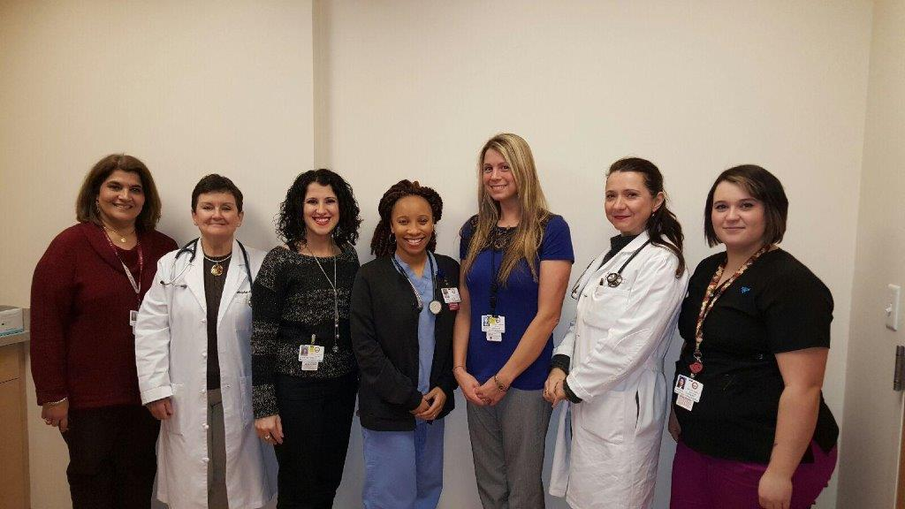
What did we work on?
What were we trying to “fix”?
Improve Diabetic Eye Exam rate from baseline of 37% to 50% by 12/31/2016.
Lucy Moushigian: Revenue Cycle Specialist
Dr. Marybeth Ferrante: Physician
Christina Rebelo: Referral Coordinator/Medical Secretary
Ricara Barnes: Medical Assistant,
Lindsey Moscato: Practice Manager
Alexandra Chabrerie, MD: Physician Champion
Andrea Carreiro: Medical Assistant

Slide 3
What did we measure?
How could we tell if a change worked?
We measured completed eye exams for all our diabetic patients
We can tell the change worked:
Improve completion from 37% to 50%
Completed reports and successive Run Charts to monitor monthly completion rates

Slide 4
Example of changes that we tested
Realized process was not streamlined and completion rates were much lower than we thought
Tested ways to improve tracking, outreach, and a office-based systematic approach to yearly eye exam completion for all diabetic patients within CMA
    Letters to patients
    Phone calls
    Full list on slide 6

Slide 5
Patient Engagement in Improvement
Asked patients to react to a letter that detailed reasons why early diabetic eye exams (DEE’s) were important
    Patient feedback - Less is more
Use each visit as an opportunity to review what routine screenings are due, regardless of the cause for the encounter.

Slide 6
Process Changes
Morning Huddle
Development of a database for identification of all CMA patients with Diabetes
Individualized patient outreach via letter/phone call
Intervention at each patient visit
Partnership with two ophthalmology offices

Slide 7
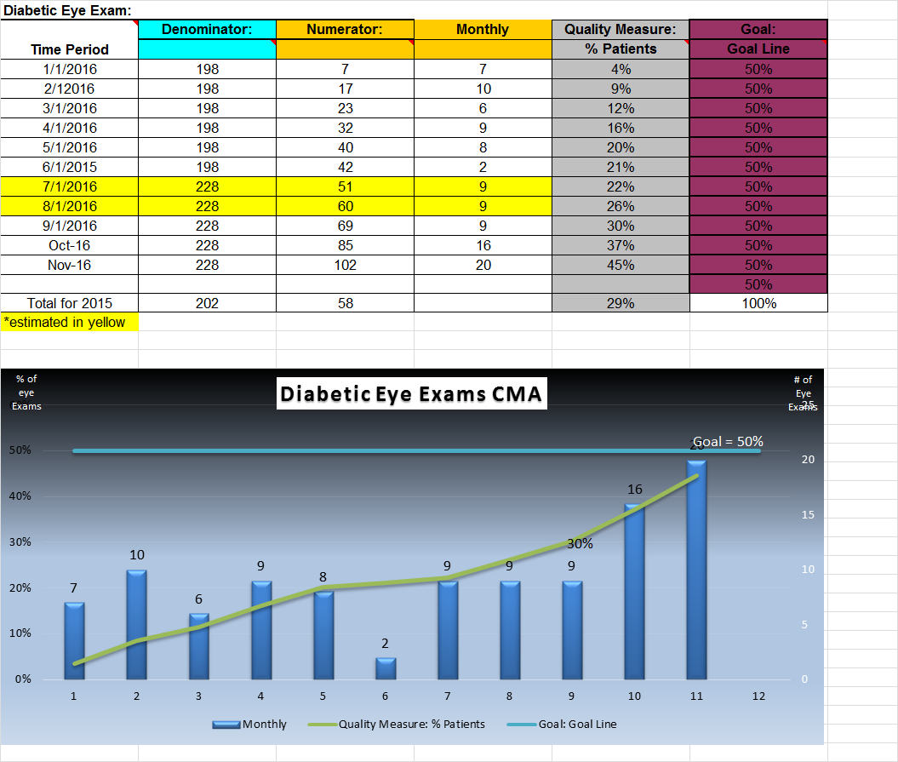
What were our results?

Slide 8
What did we learn?
We are not as good as we thought we were!
Patients have little knowledge as to why this is so important
Starting early in the year is better
  Exams are clustered in last quarter
  Not on a 365 day cycle
Return of exam results needs improvement

Slide 9
What’s next?
Improve our AIM statement to 75%
Continue to use PDSA
Continue to run monthly reports to see when patients are due for eye exams/remind patients that they are due

Slide 10
What we will keep doing
Keep running graphs.
Reviewing the data
Keep engaging patients regularly

